Slide 1
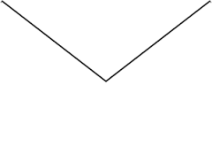

Substance Use and the Family
Scott Hadland, MD, MPH, MS
Assistant Professor of Pediatrics
Boston Medical Center / Boston University School of Medicine
scott.hadland@bmc.org
@DrScottHadland

Slide 2
Disclosures / Funding Source
Conflict of interest statement:
  I have no commercial relationships to disclose
  I will not be discussing any unapproved uses of pharmaceuticals or devices
Funding Sources:
  National Institute on Drug Abuse K23DA045085, K23DA045085-S1, L40DA042434, UM1DA049412, R01DA046527-S1
  Thrasher Research Fund Early Career Award
  Academic Pediatric Association Young Investigator Award

Slide 3

By the end of the module, learners will:
Describe the overall patterns of substance use among youth in the US;
Recognize the links between parental and youth substance use disorders, including those attributable to genetics and environment; and
Identify opportunities to prevent the development of substance use disorder among young people by intervening with families.

Slide 4
Part 1:
Youth Patterns of Substance Use

Slide 5
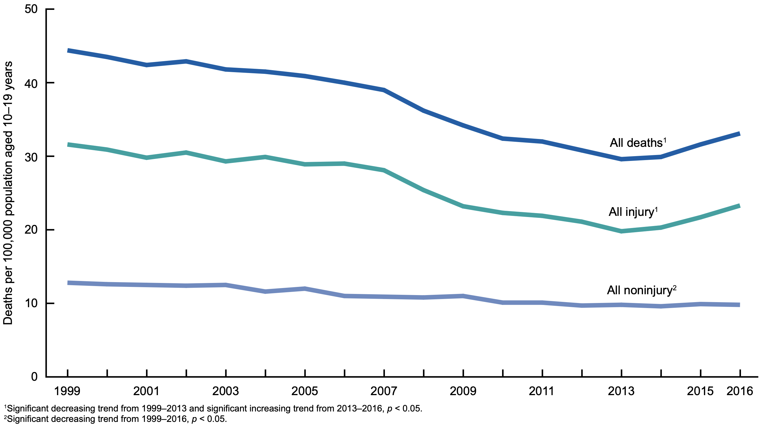
Teen Substance Use: Why Care?
3 Leading Causes of Death among Adolescents (per 100,000):
Motor vehicle crashes (12.4)
Suicide (10.0)
Homicide (8.6)
Curtin SC et al. National Center for Health Statistics, 2018

Slide 6
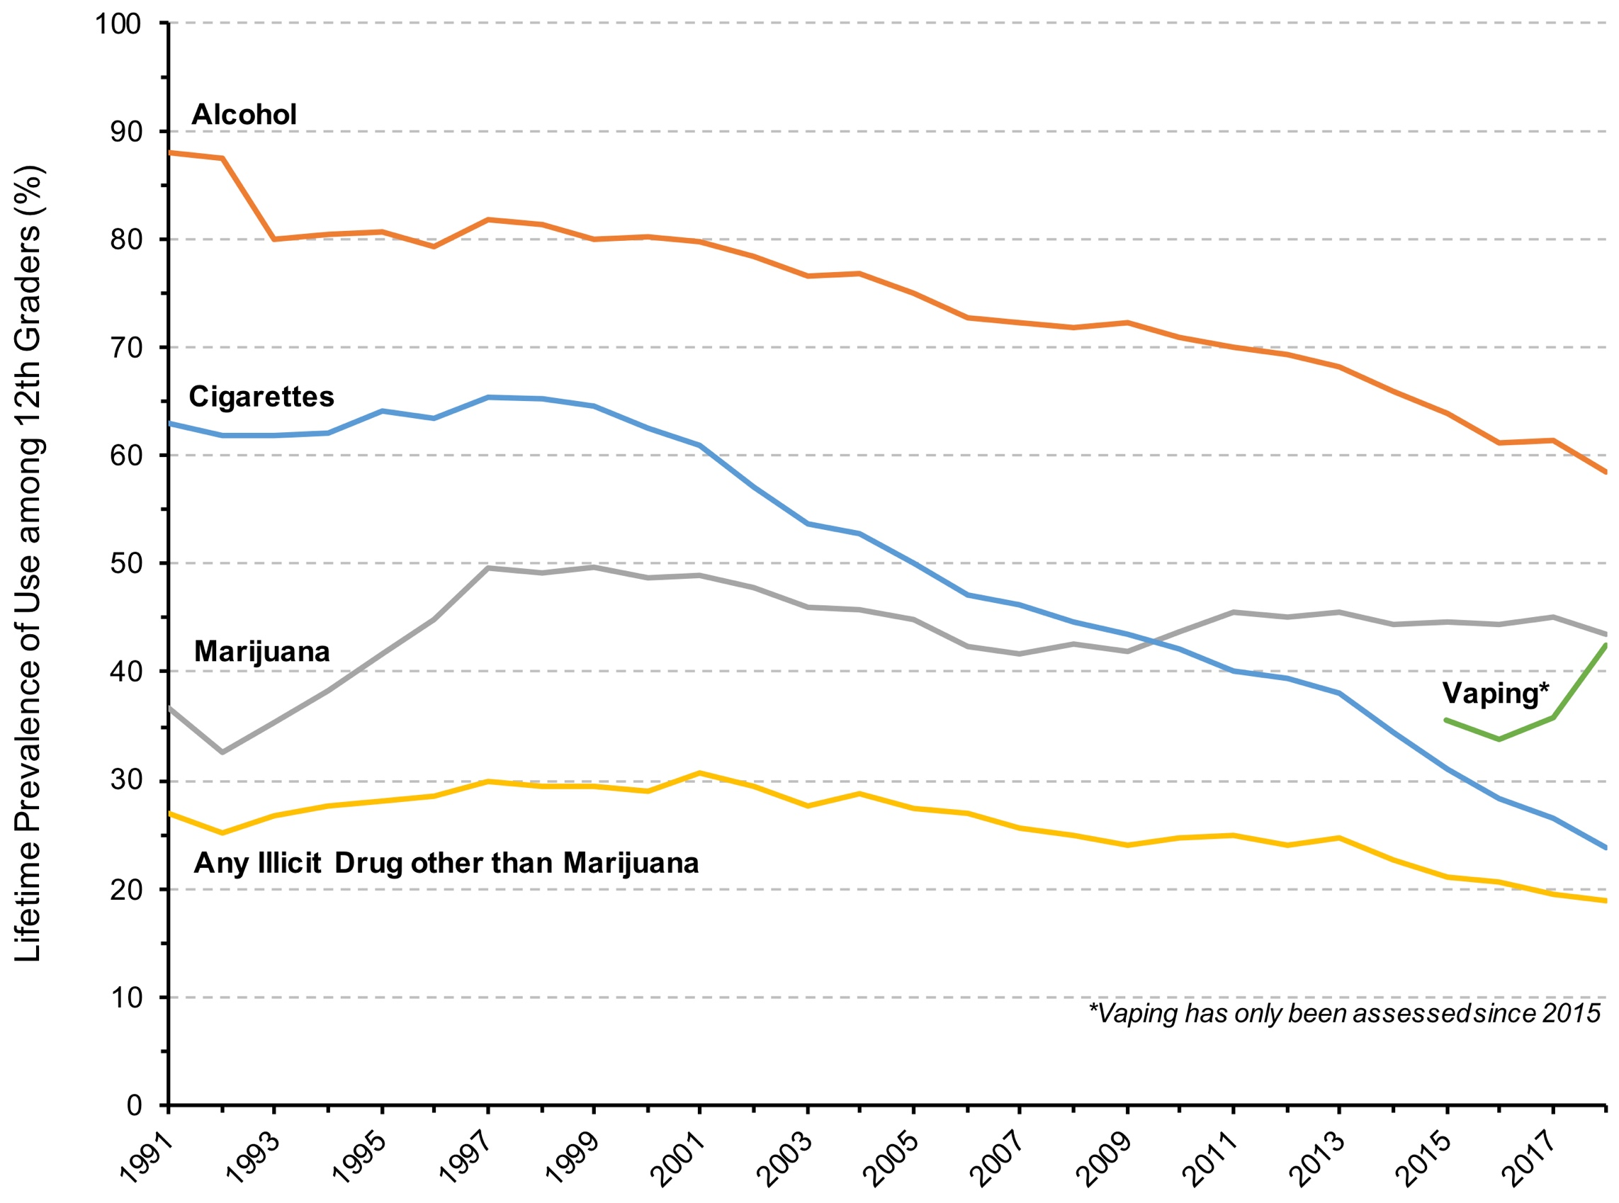
An Overview
Monitoring the Future 2018, University of Michigan, 2018

Slide 7
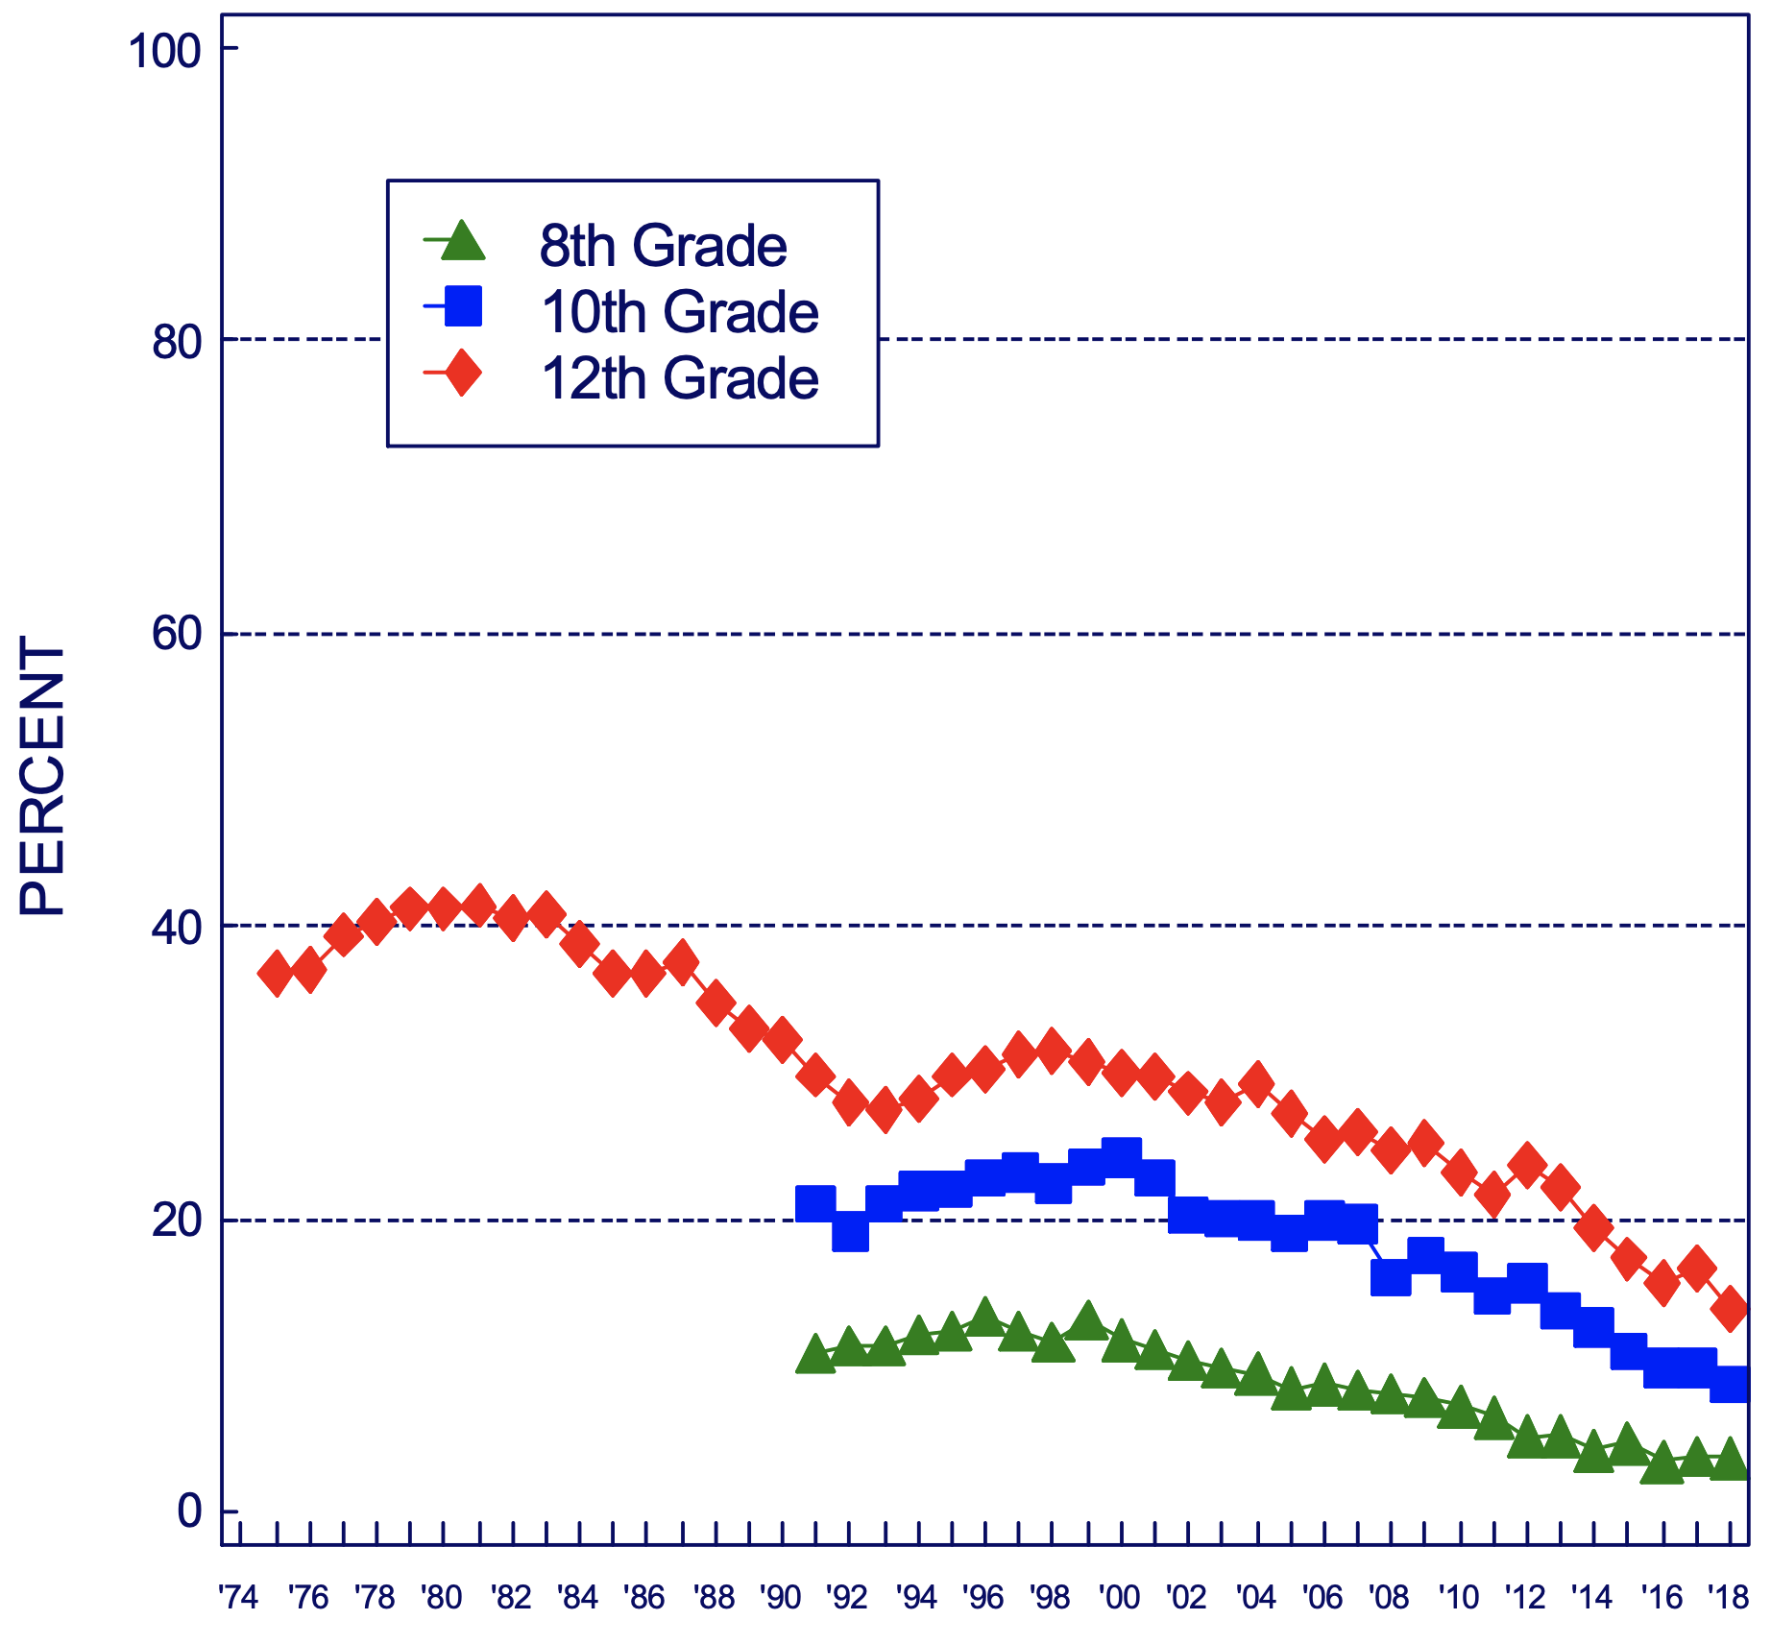
Binge Drinking
% who had ≥5 drinks in a row in past 2 weeks
However, in recent years, decline in binge drinking has slowed among…
  Girls
  Black adolescents
  Adolescents from low socioeconomic backgrounds
Monitoring the Future 2018, University of Michigan, 2018

Slide 8
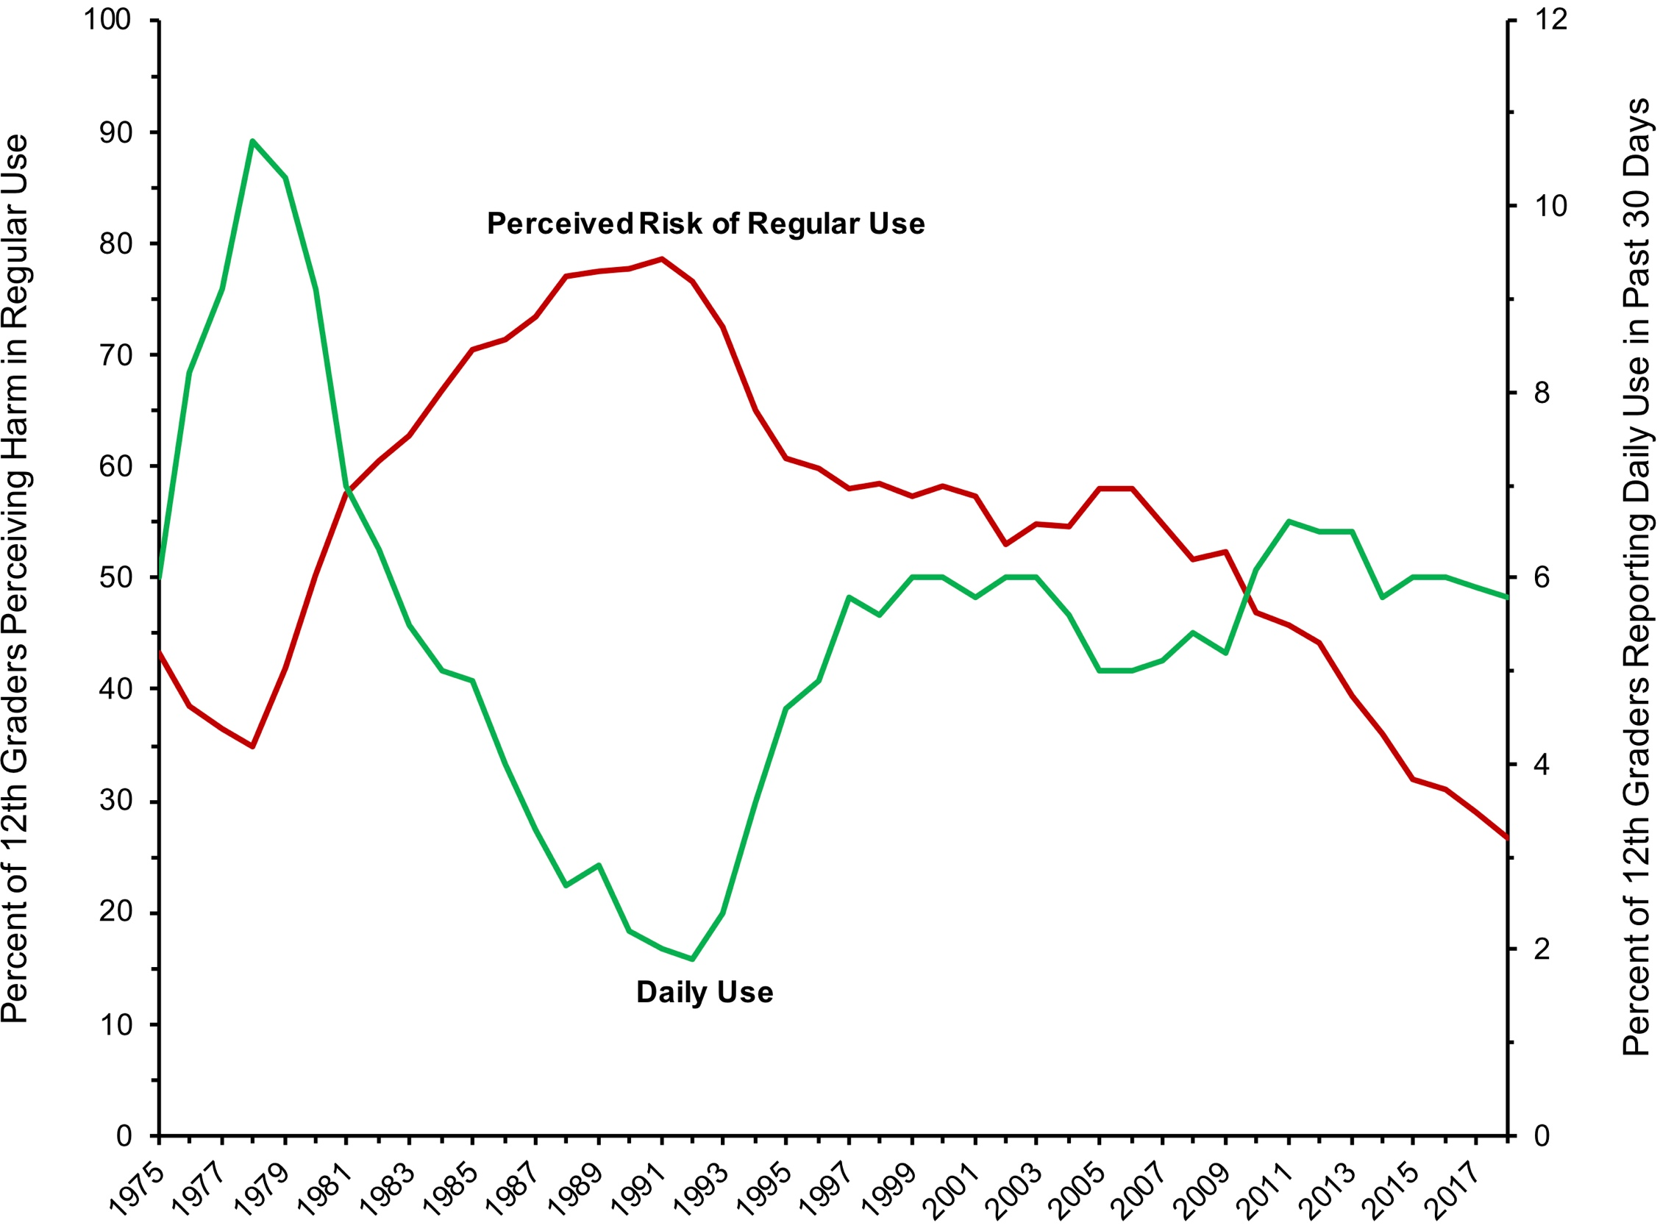
Marijuana Perceptions & Use
Monitoring the Future 2018, University of Michigan, 2018

Slide 9
What Are Potential Health Risks?
Double the odds of motor vehicle accident
No cardiovascular or lung effects among youth…
But, some concerning data on immediate effects on:
  Male sexual function
  Gastrointestinal function
Numerous studies showing brain structure and function changes, with poorer IQ attainment among individuals who used heavily as adolescents
Multiple emerging studies showing links with depression, anxiety following heavy use during adolescence
W Hall & L Degenhardt. Lancet, 2009;374(9698):1383-91

Slide 10
Misuse of Prescription Opioids
1 in 29 students
(About one student in a typical classroom)
*Note: Only 0.4% of all 12th grade students reported past-year heroin use in 2018
Monitoring the Future, University of Michigan, 2019

Slide 11
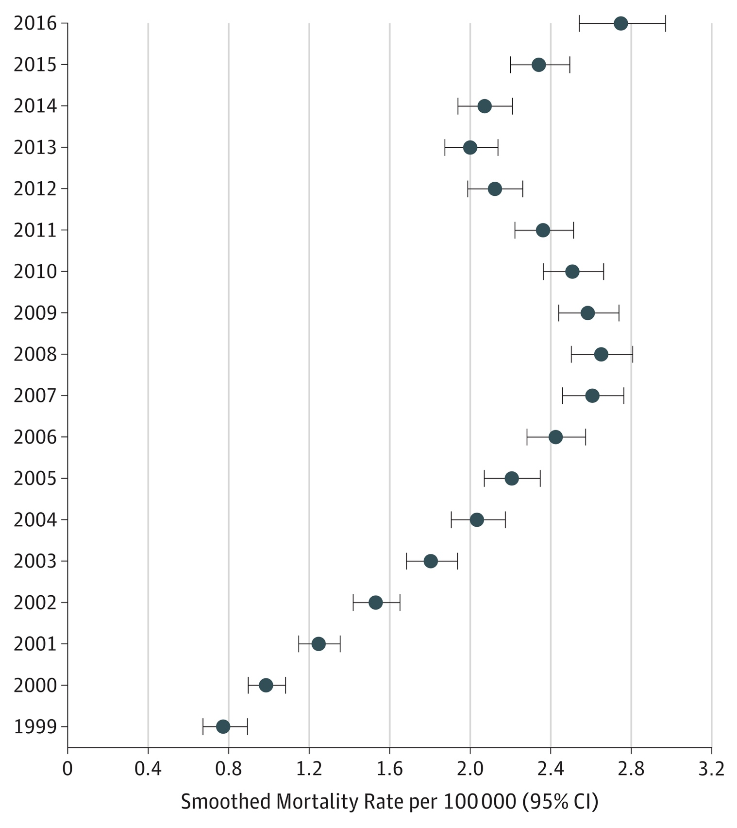
Trends in Teen Overdose Deaths
Between 1999 and 2016, overdose deaths rose among 15- to 19-year-olds:
  95% for prescription opioids
  405% for heroin
  2925% for synthetic opioids (i.e., fentanyl)
Gaither JR, et al. JAMA Netw Open. 2018;1(8):e186558.
Notes:
So I have now told you that overall opioid use has been decreasing but that hospitalization for opioid poisoning might be increasing- until really last week there was question about what was happening with overdose deaths in this age group- but then this data brief was released by the CDC and the NCHS- showing that there has been an increase in the last couple of years in overdose deaths (from any substance)

Slide 12
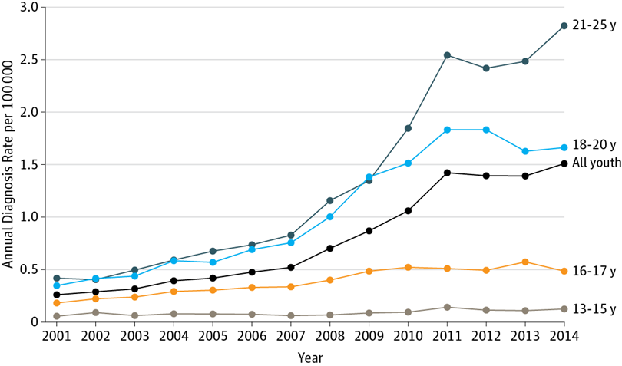
Trends in Opioid Use Disorder
Hadland SE et al. JAMA Pediatr, 2017;171(8):747-55.

Slide 13
Take-Home Points
Substance use contributes to the three leading causes of death among young people:
  Motor vehicle crashes
  Suicide
  Homicide
For many substances, use is declining, but…
  Heavy use is increasing for other substances (e.g., marijuana)
  Declines in use are not equal across all youth (e.g., girls, black adolescents, and adolescents from low socioeconomic backgrounds)
  Harms of use persist, and may be intensifying for some substances (e.g., marijuana, opioids)

Slide 14
Part 2:
Addiction and Families

Slide 15
“Addiction”: Substance Use Disorder
Substance use occurring over 12 months with ≥2 of:
Taken in larger amounts / over a longer period than intended
Persistent desire / unsuccessful efforts to cut down
Excess time spent in activities to obtain, use or recover from substance
Craving
Failure to fulfill major role obligations at work, school, or home
Continued use despite having persistent / recurrent social or interpersonal problems
Social, occupational, or recreational activities given up
Recurrent use in situations in which it is physically hazardous
Continued use despite knowledge of having a persistent or recurrent physical or psychological problem
Tolerance
Withdrawal
Mild:
2-3 criteria
Moderate:
4-5 symptoms
Severe:
≥6 symptoms
Diagnostic and Statistical Manual of Mental Disorders 5, APA, 2013.

Slide 16
Co-Occurring Concerns
1. Sensation-Seeking
3. Anxiety Sensitivity
2. Impulsiveness
4. Hopelessness
Dysregulation that is addressed with substance use
Conrod PJ, et al. JAMA Psychiatry, 2013;70(3):334-42

Slide 17
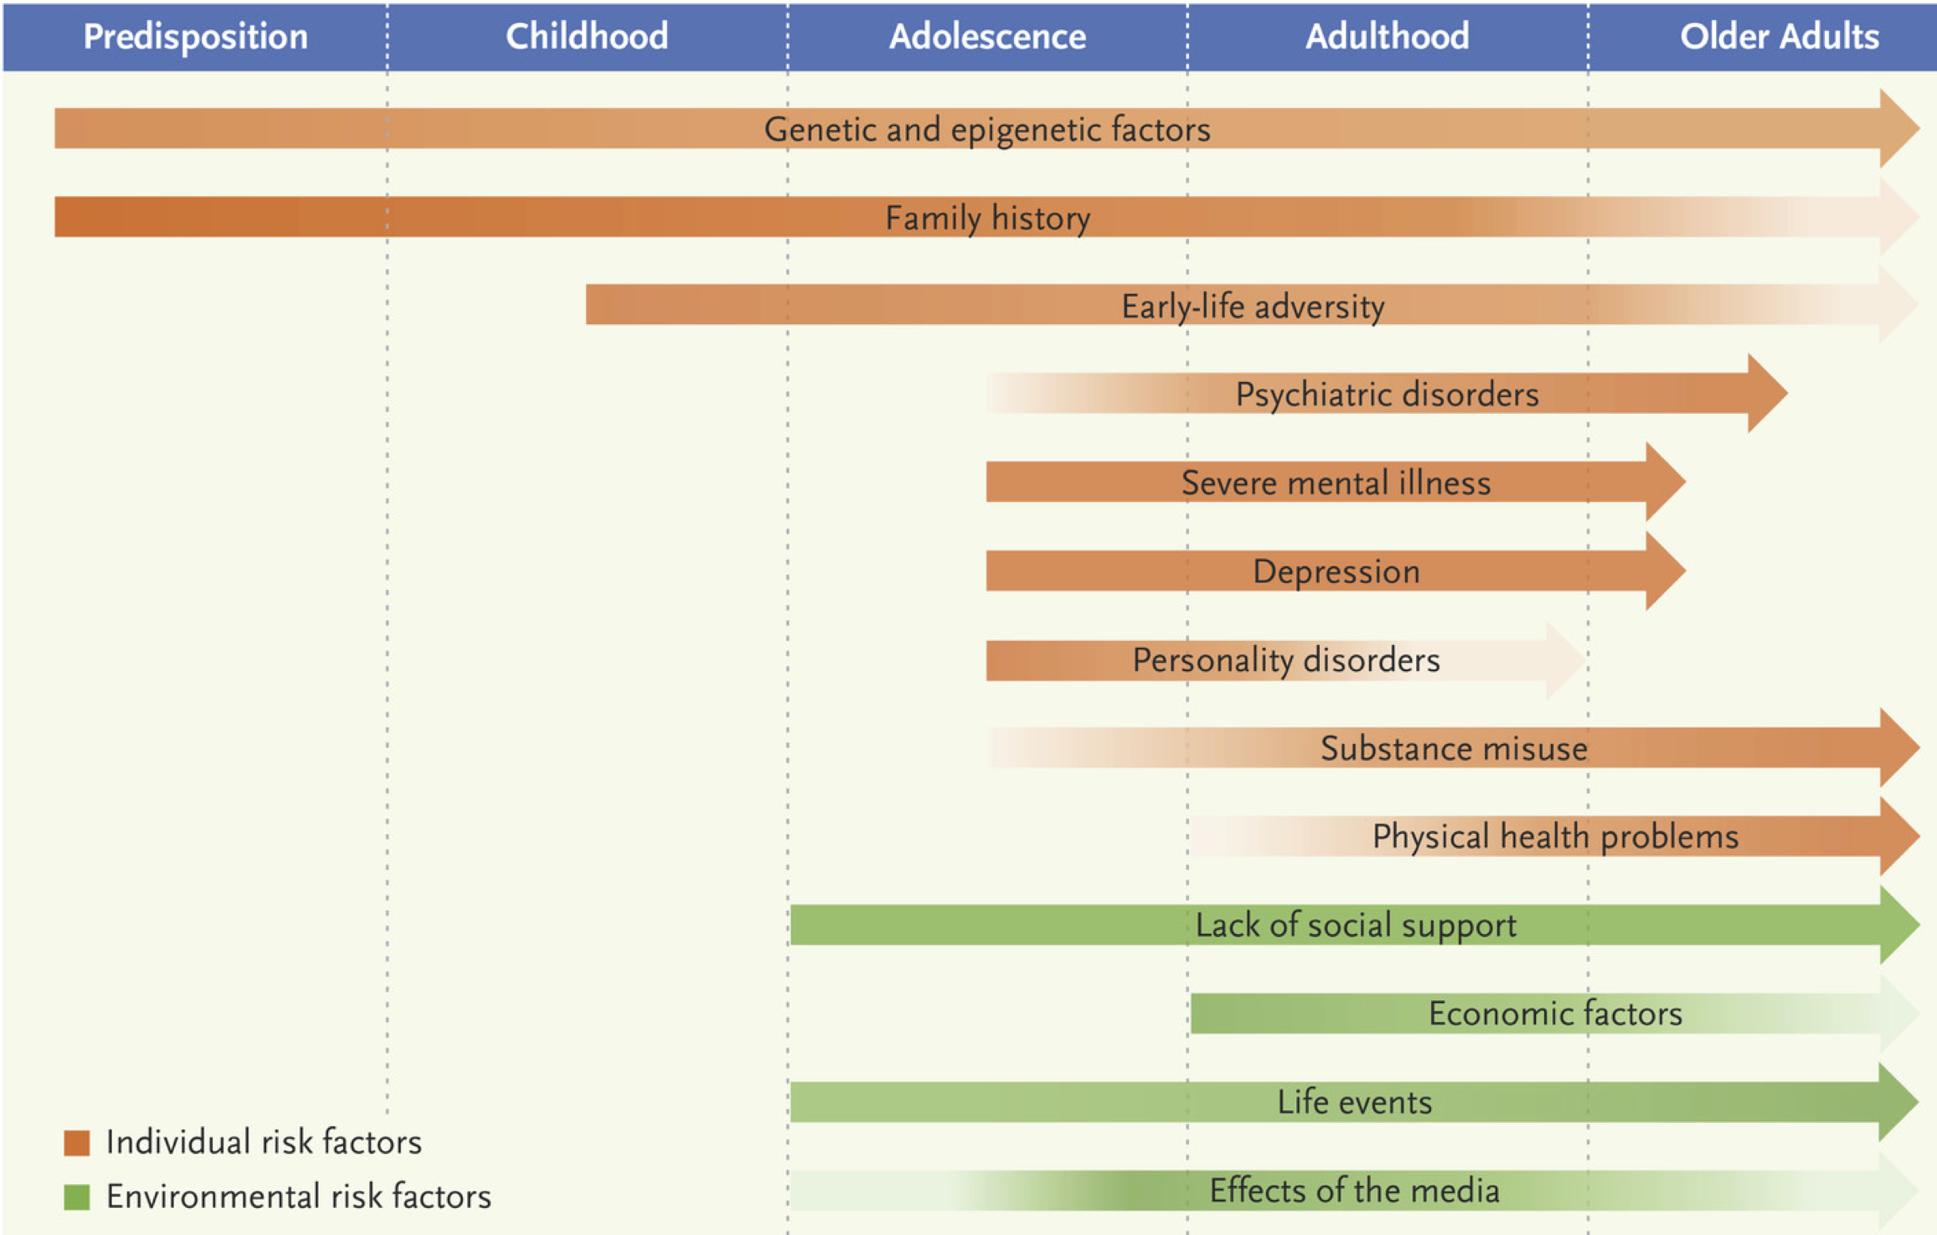
Life Course & Substance Use
Adapted from Figure on suicide from: S Fazel, B Runeson. N Engl J Med 2020;382:266-274.

Slide 18
Risk for SUD in Families
Study of 231 adults with substance use disorder, 61 adults without substance use disorder, and 1,267 first-degree relatives
Likelihood of first-degree relative having a substance use disorder was 8 times greater
There was crossover of substances
  Among individuals with opioid, cocaine, cannabis, and alcohol use disorders, the most common addiction in a first-degree relative was an alcohol use disorder
KR Merikangas et al. Arch Gen Psychiatry. 1998;55:973-9.

Slide 19
Parents and Risk for SUD
Genetics / Biology
Genes related to substance use, mental health, novelty/risk seeking
Sex
Genomic imprinting
Drug receptors (up- and down-regulation)
Neuroplasticity
Drug metabolism
Environment
Use by family
Attitudes/messaging about substances
Parental monitoring
Limit setting
Parental provision of substances
Stable vs. chaotic home environment
Adapted from: National Institute on Drug Abuse, 2004
Spirito A, et al. J Child Adolesc Subst Abuse. 2015;24(5):308-22

Slide 20
Part 3:
Opportunities for Family Intervention

Slide 21
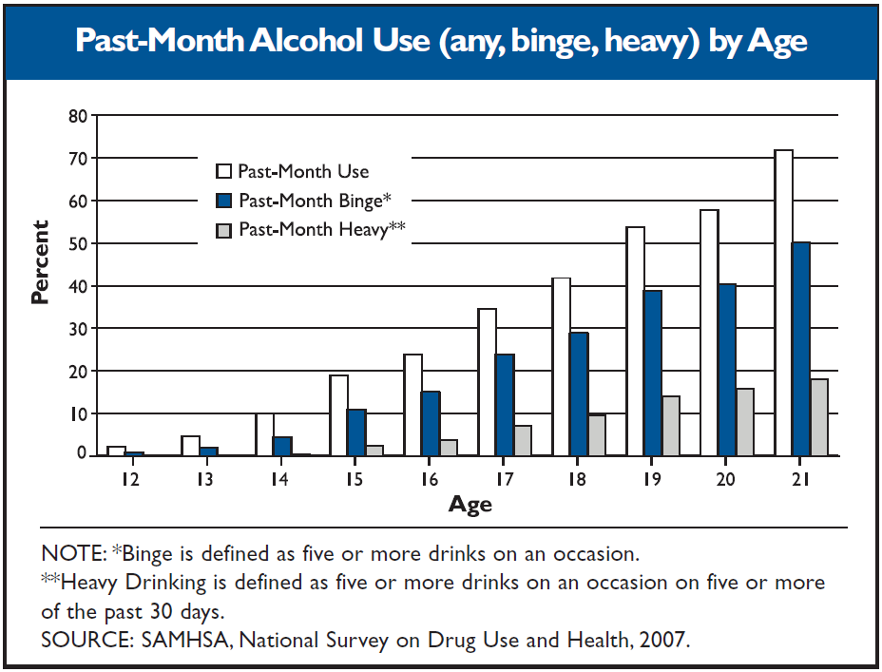
Adolescence: A Time to Intervene
Substance use (including heavy substance use) typically begins during adolescence…
National Institute on Alcohol Abuse and Alcoholism, 2009
Treatment Episode Data Set, 2017

Slide 22
A Developmental Condition
Brain development:
  Reward system developed (e.g., nucleus accumbens), and planning centers developing (e.g., prefrontal cortex)
Social development
  Coping skills, interpersonal relationships
Gas Pedal:
Reward System
Brake:
Planning Centers
The fact that this development is not yet complete means youth are at risk
Substance use during this critical time may permanently alter processes
Adolescent / Young Adult Development

Slide 23
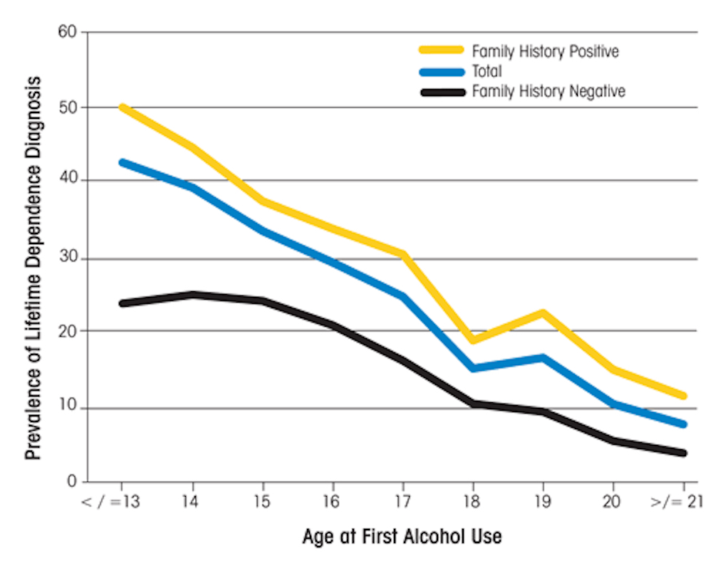
The Goal: Delaying Onset of Use
Source: 2001-2002 National Epidemiologic Survey on Alcohol and Related Conditions

Slide 24
Goals of Family Talk
Educate parents and children about substance use and resiliency
Instill hope in families struggling with substance use
Help family members talk about substance use and create a shared family substance use narrative
Maximize current family assets and build resiliency
Strengthen coping skills such as communication and problem-solving
Address any existing child problems
Help families plan for the future and prevent the onset of difficulties in the children

Slide 25
Substance Use Protective Factors
Protective Factors | Family Talk Opportunities
Strong and positive family bonds | R, C
Parental monitoring of children’s activities and peers | E, C, P
Clear rules of conduct that are consistently enforced within the family | E, C, P
Involvement of parents in the lives of their children | R, C, P
Success in school performance; strong bonds with institutions, such as school and religious organizations | R, C
Adoption of conventional norms about drug use | E, R, C
E = Education, R = Resiliency, C = Communication, P = Problem-Solving

Slide 26
Thank You!
Funding support from National Institute on Drug Abuse, Thrasher Research Fund, Academic Pediatric Association, Division of General Pediatrics at Boston University School of Medicine
Email: scott.hadland@bmc.org
Twitter: @DrScottHadland

