Slide 1

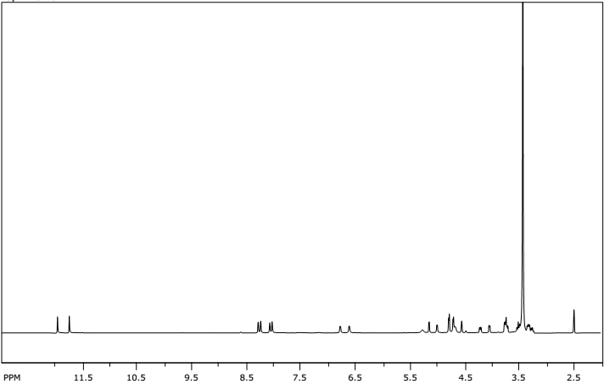
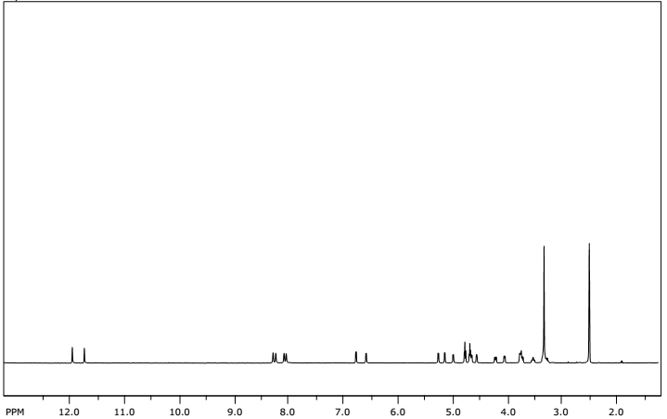
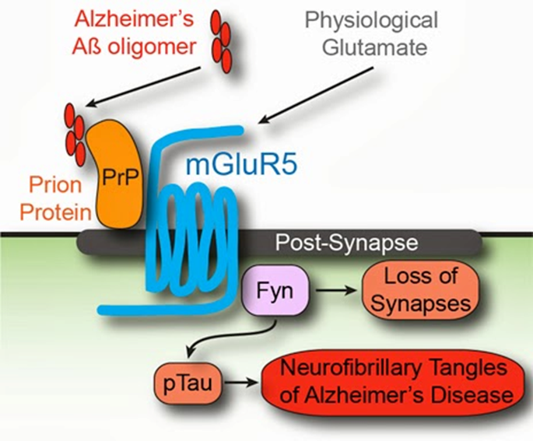
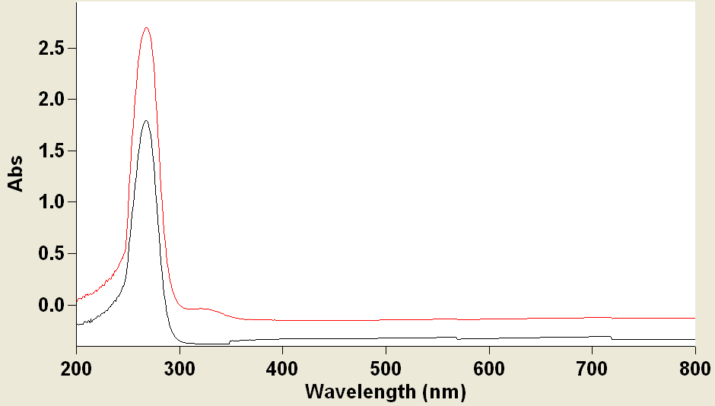
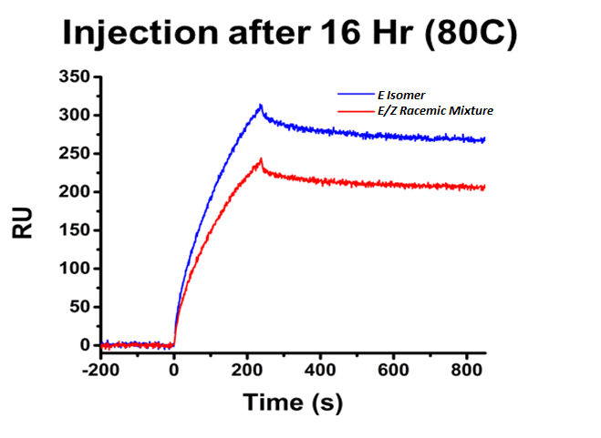
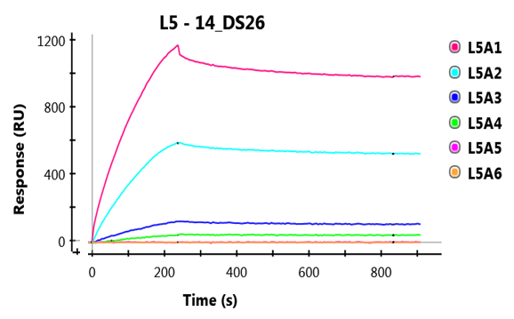



Synthesis of novel amyloid-β oligomer inhibitors for the treatment of Alzheimer's disease
Gerardo Colon, Alexis Courtney, Aaron Beeler
Background
Methodology / Synthesis
Evidence for NCI VS Recrystallized Conflict
Alzheimer's disease is a condition which affects over five million Americans, making it the sixth leading cause of death in the United States. This, combined with the fact that Alzheimer’s currently had no known cure, makes it a particularly expensive drain on the medical industry. In the 2013 fiscal year alone, caregivers provided a total of 17.7 billion unpaid care hours, which amounts to over $220 billion.
However, an emotional toll is very common among the caregivers of Alzheimer-afflicted patients. A survey shows that most workers rate the stress involved in taking care of these patients as “high” or “very high”. Not only that, workers have been shown to begin exhibiting symptoms of depression overtime, due to the nature of the disease.
A certain ligand (DS-26) , which has been previously proven to be effective against Alzheimer’s in in silico studies was synthesized and tested via Surface Plasmon Resonance (SPR). In addition, variations of this ligand ( DS-207 through DS-307) were synthesized and tested via SPR as well. Characterization was done via various methods, such as NMR, MS, and UV-Vis spectroscopy.
Currently, attempts are being made at identifying strange behavior concerning the synthesized DS-26 (purified by recrystallization) and a version of DS-26 synthesized by the NCI.
DS26 Synthesis
TEM Imaging
Oscar’s Compound
Completely Pure Compound
Recrystallized Compound
DS26 Analog Synthesis
NMR Spectroscopy
Images courtesy of BU Med
DS-26 and its Analogues
Alzheimer’s Mode of Action
DS 207
DS 300
DS 301
UV-Vis Spectroscopy
NCI Sample
Recrystallized Sample
DS 303
DS 307
DS 26
Um, J.; Kaufman, A.; Strittmatter, M. Neuron. 2013. 887-902.
SPR Results
Objectives
Future Work
Identifying the reason for strange behavior between NCI DS-26 and recrystallized DS-26.
Achieving a successful synthesis of DS-26 and it’s variations.
Analyze the activity of DS-26 and it’s analogues via SPR.
Radioactive Labeling
Continued Analysis of the Mechanism of Action
Biochemical Testing
Further investigation into why compound isn’t active
This research was supported by …
SPR Data Courtesy of Dr. James Heeres, BU Medical Campus
Notes:
16HT Diagram is E to E/Z
For SPR: Dr. James Heeres, BU Medical Campus
TEM: Images courtesy of BU Med

